Slide 1
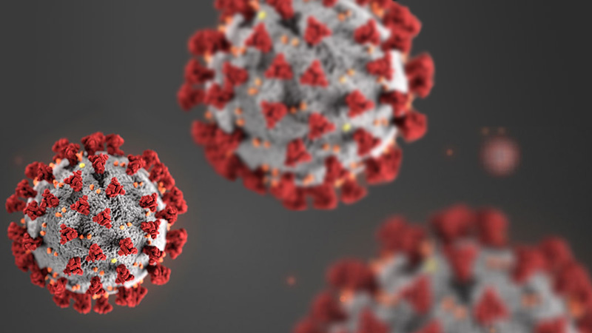
What are we doing about Covid-19?

Slide 2
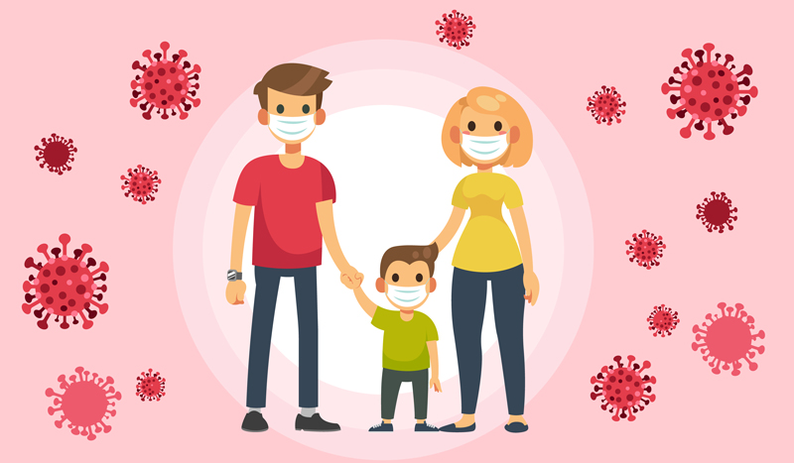
What are they doing?
They are wearing face masks.

Slide 3
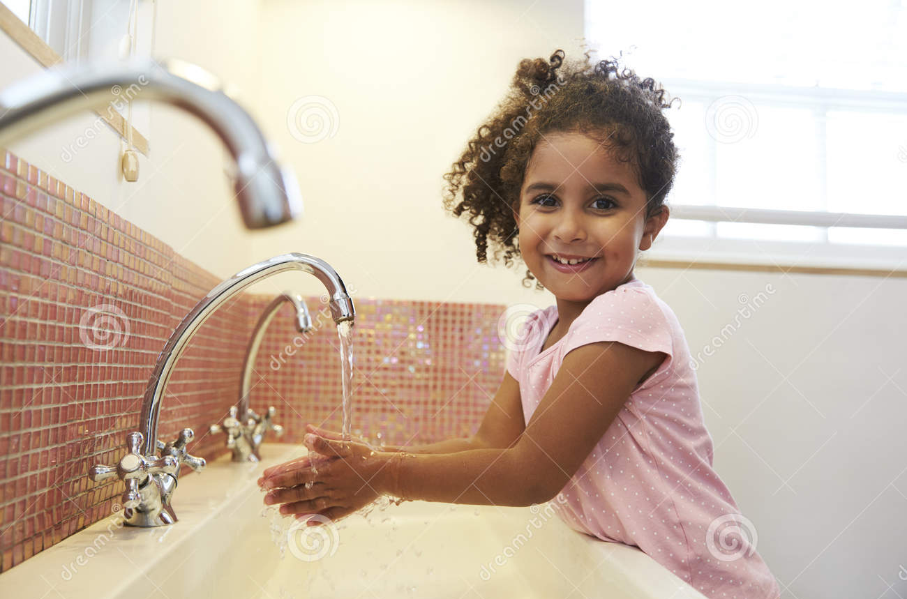
What is she doing?
She is washing her hands.

Slide 4
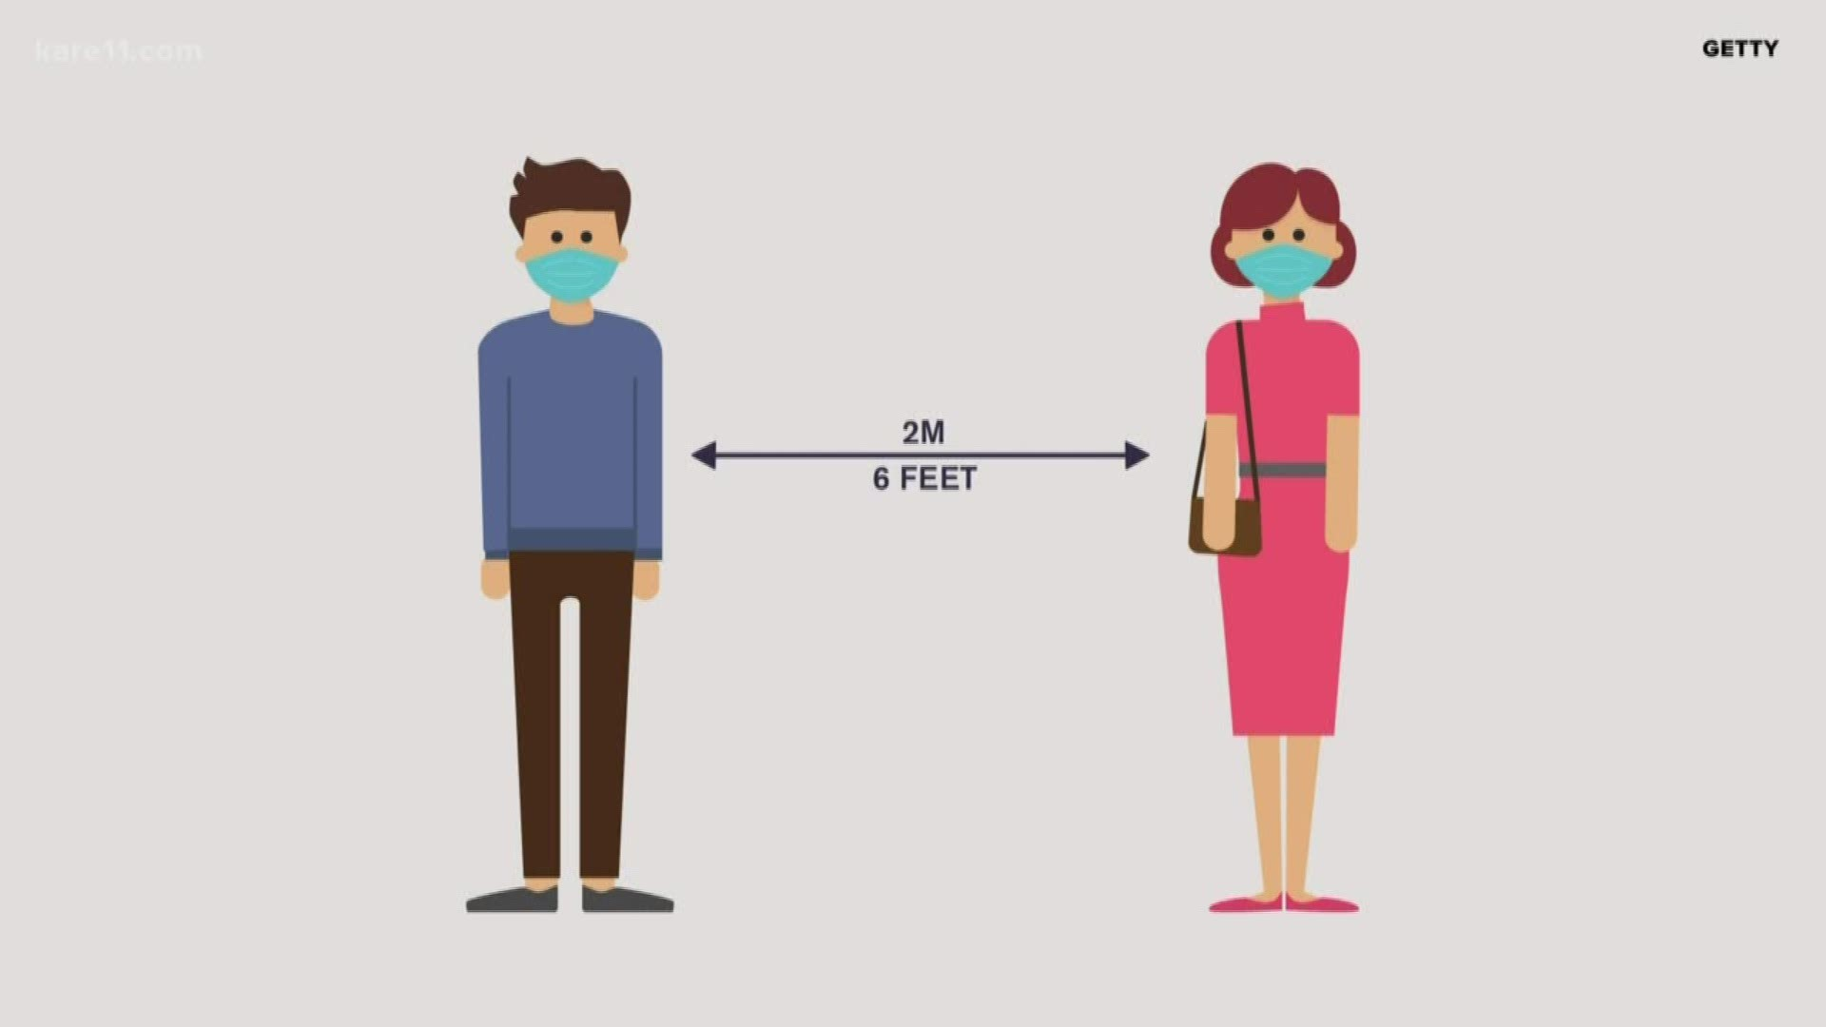
What are they doing?
They are social distancing.

Slide 5
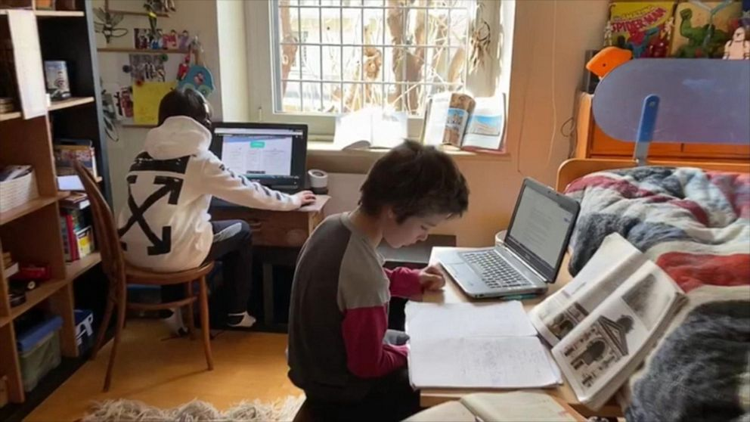
What are they doing?
They are going to school online.

Slide 6
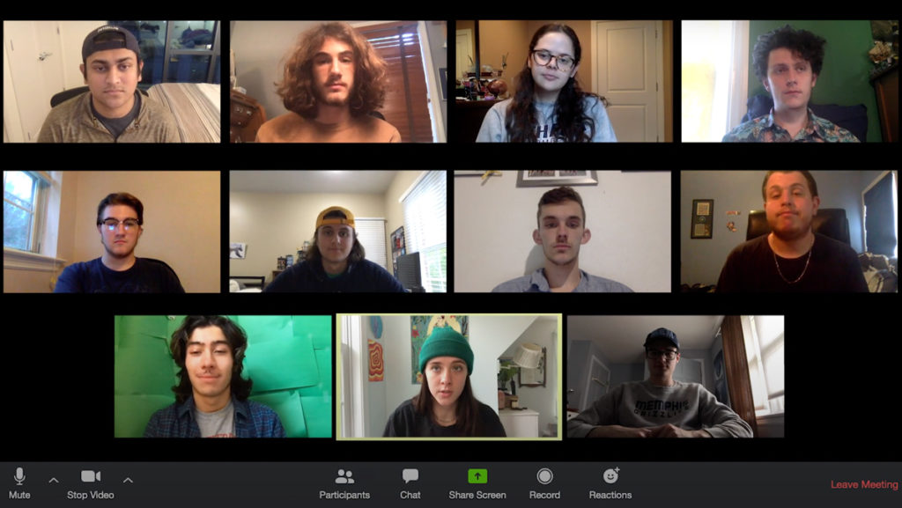
What are they doing?
They are working from home.

Slide 7
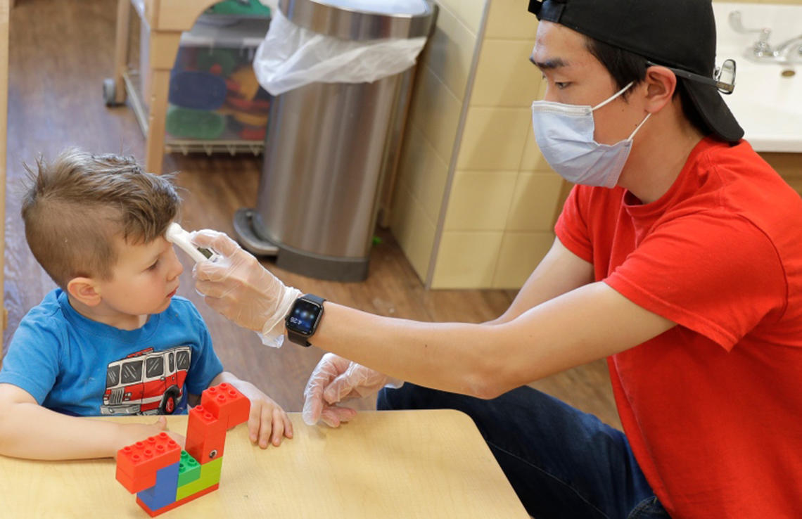
What are they doing?
The little boy is getting his temperature taken.
The young man is taking the boy’s temperature.

Slide 8
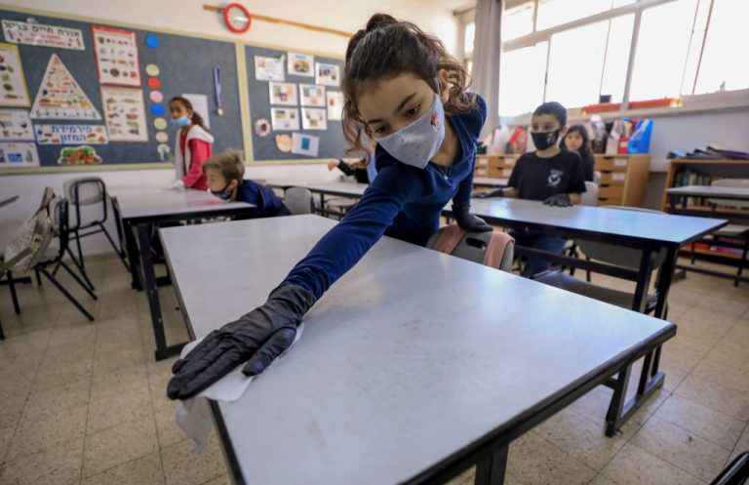
What is she doing?
She is cleaning a table.

Slide 9
What is she doing?
She is getting a Covid-19 test.

Slide 10
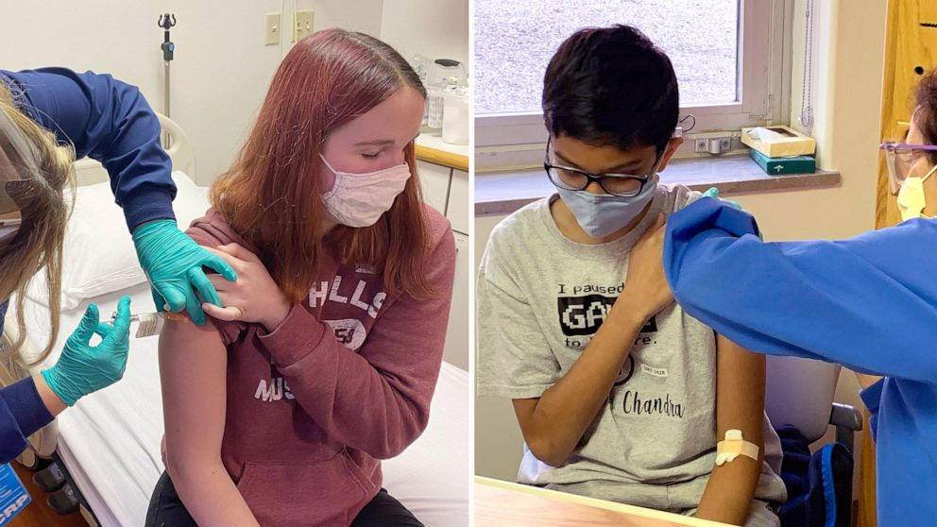
What are they doing?
They are getting vaccinated.

Slide 11
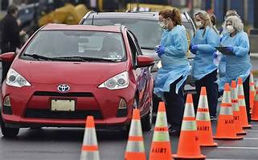
What are they doing?
They are giving vaccinations at a drive-through location.

Slide 12
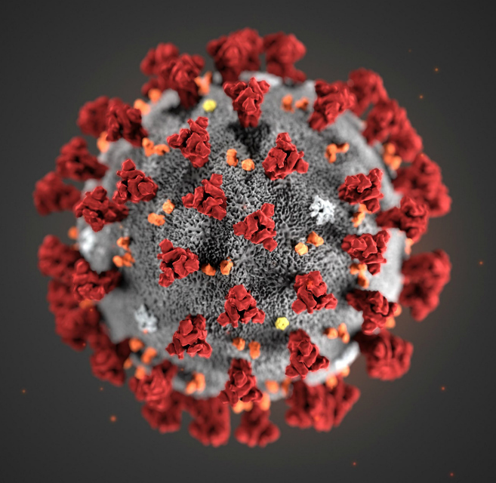
What are YOU doing about Covid-19?

